Slide 1
INVESTMENT ASSIGNMENT SUBMISSION
Name: Prabhat Mishra

Slide 2
Business Objectives
An asset management company Spark Funds wants to make investments of 5 to 15 million USD per round of investment in companies across different sectors in different Geographies.
The objective is to identify:
Investment Type
Countries ( English Speaking)
Sectors
for making investments based on the investments where other players are majorly investing.

Slide 3
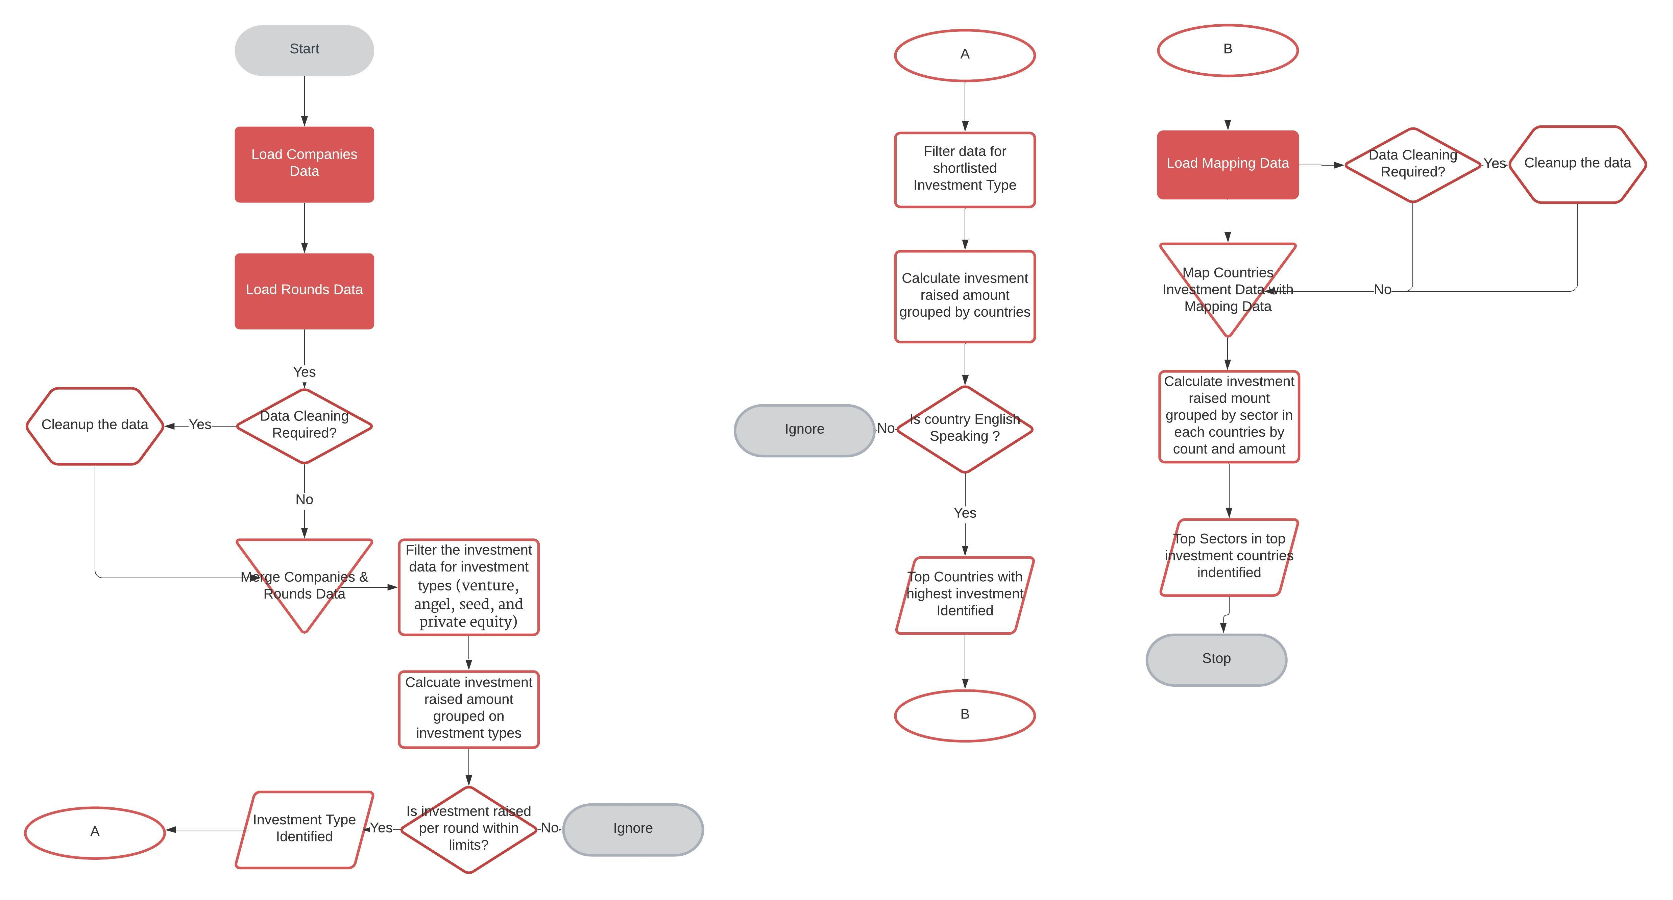
Approach

Slide 4
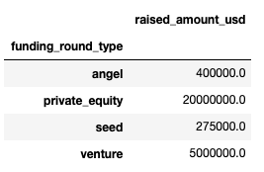
Analysis – Investment Type
Following steps are performed for identifying Investment Type:
Read the companies and rounds2 data.
Correct the data quality issues like string manipulation, data type issues etc
Merge rounds2 and companies data to associate investments against companies
Identify if there are missing values for investment type
Filter data for main investment types ( “angel”, “private equity”, “seed” and “venture”)
Plot box plot to identify the outliers
Calculate the most representative value of the investment amount for each of the four funding type
Based on the investment budget per round, best suited investment type is “Venture”

Slide 5
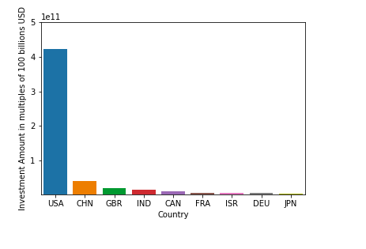
Analysis – Investment Country
Following steps are performed for identifying top Countries suited for investment:
Filter the master data for shortlisted investment type – venture
Calculate the raised amount by each country in all the sectors
Plot the bar chart to identify the top countries with the highest amount of funding
Shortlist the countries which are English speaking ones.
Top English Speaking Countries are “USA, UK and India” with highest total investments.

Slide 6
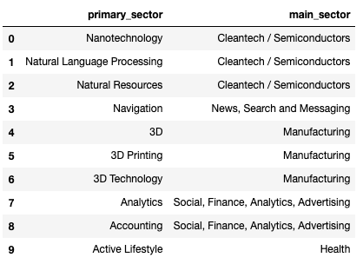
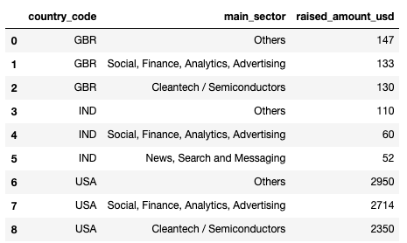
Analysis – Sector
Following steps are performed for identifying top Countries suited for investment:
Rad the sector mapping sheet.
Correct the data quality issues like string manipulation etc.
Filter the master data for shortlisted investment type – venture and top 3 countries.
Unpivot mapping data to get sub sector and main sector information.
Apply Business rule decided for identifying the primary sector and main sector for each company.
Split the data into 3 countries
Calculate the total number of investments and the total amount of investments in each main sector for each of the three countries.
Shortlist the main sector for each countries with the highest investments.

Slide 7
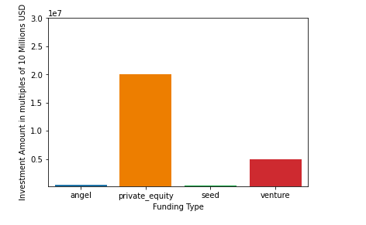

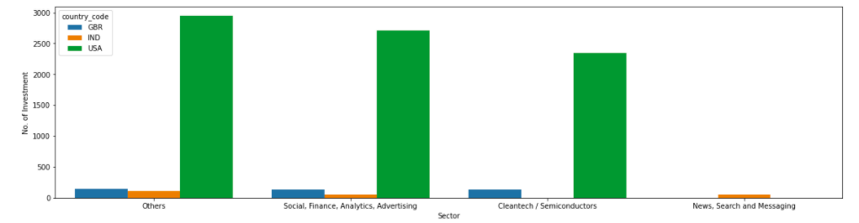
Sectored Wise Investment in selected Countries
Goals Outcome for Investment
Investment Type Selection
Country for Investment

Slide 8
Conclusion
Based on the analysis performed on the companies and investment data for each sector. Below are the suggested outcomes for Sparks Funds:
Investment in Venture Funds will be best suited.
English Speaking Countries: USA, UK and India are highest among Investment received
Top Sectors in highly invested companies are:
Others
Cleantech / Semiconductors
Social, Finance, Analytics, Advertising
News, Search and Messaging

